Slide 1
Enhancing Cloud Security Through Zero Trust Principles using Identity and Access Management and Multi-Factor Authentication in AWS.
By Lucas Malik (22806287)
University of Northampton
BSc (Hons) Cybersecurity and Web Development
Supervisor: Amir Minai

Slide 2

Issues in Cloud Security
Rapid adoption of cloud computing has introduced new security challenges.
Applications are accessible from numerous networks and devices, increasing the attack surface.
Prone to insider threats, compromised accounts and attacks that bypass perimeter defences.
Traditional security methods have proven insufficient in modern environments.

Slide 3
What is the Zero Trust Approach?
Assume Breach: Always a weakness or entry point within a system.
No Implicit Trust: No user or device should be trusted by default.
Continuous Verification: Every access request is verified, regardless of location.
Least Privilege: Users and devices given only the necessary permissions required.
“Always Verify, Never Trust” - John Kindervag (2009)

Slide 4
Project Aims and Objectives
Aim: To design and develop an experimental demonstration of a secure cloud-based web application in AWS that leverages Zero Trust principles using IAM and MFA.
Objectives:
Laying the Foundation: Planning and Initial Research
Building the Foundation: Application Development and Setup
Securing the Application: Identity and Access Management
Monitoring and Threat Detection: Initial Vulnerability Assessment
Hardening the System: Refinement and Post-Implementation Testing
Measuring Success: Evaluation and Documentation

Slide 5
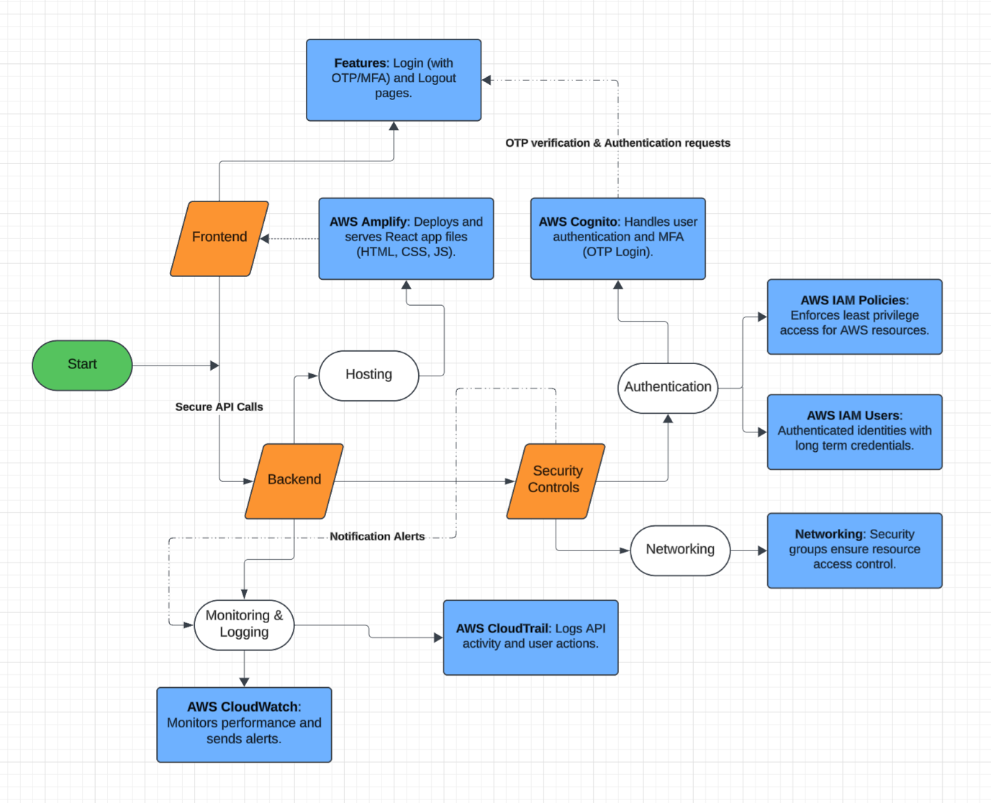
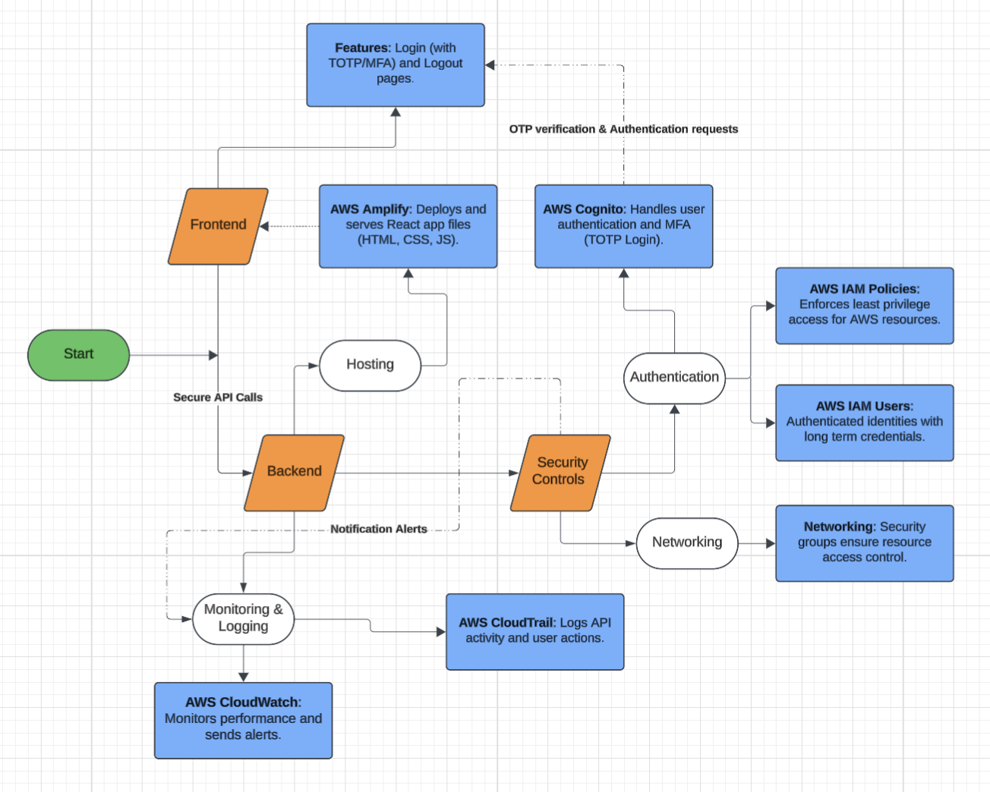
System Architecture Design
Frontend
Login and Dashboard Pages.
React.js (HTML/CSS/JS)
Backend
Monitoring and Logging.
Hosting Application (Amplify).
Authentication (Cognito).
IAM Users and Groups.

Slide 6
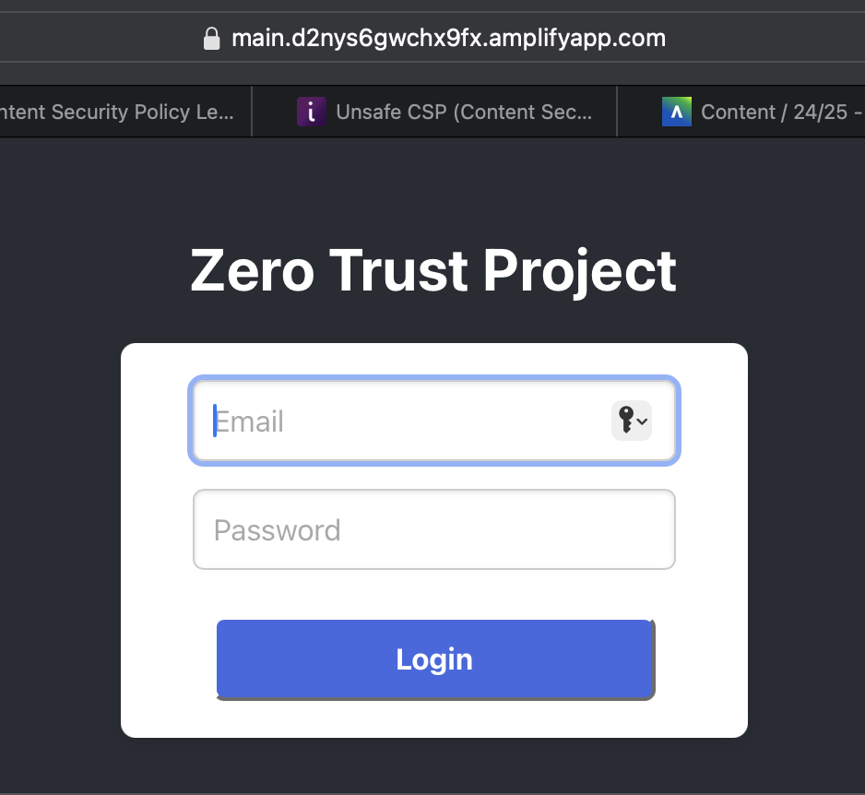
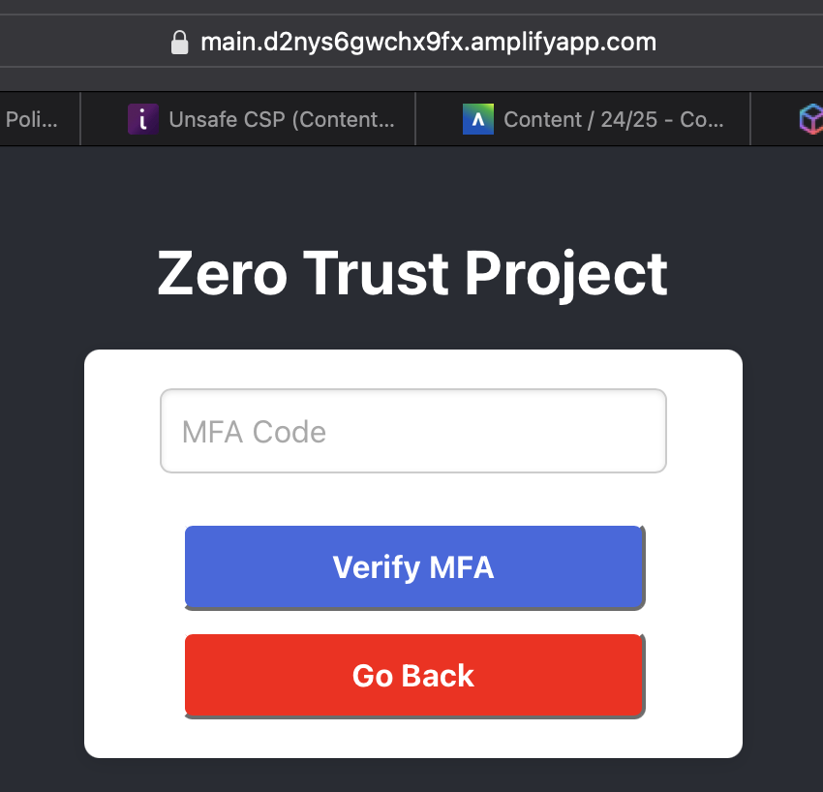
Authentication Workflow (TOTP MFA)

Slide 7
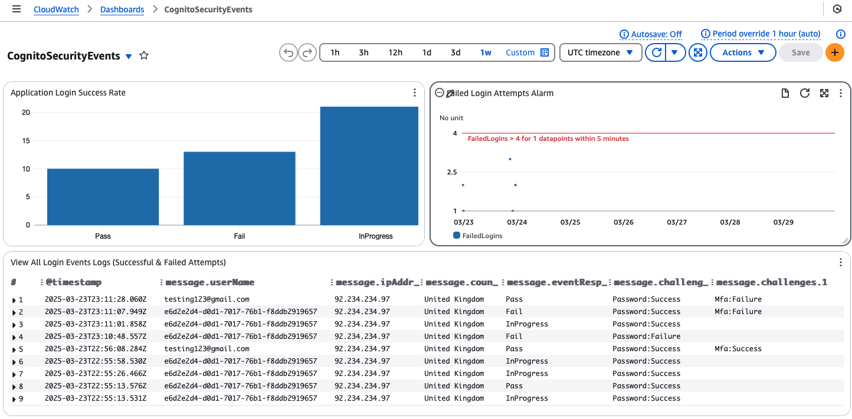
CloudWatch Monitoring and Alerts

Slide 8
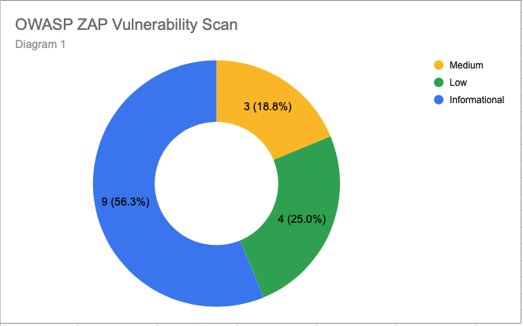
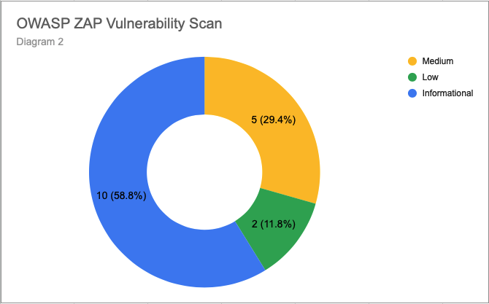
Vulnerability Assessments Results
Pre-Implementation Tests:
3 Medium, 4 Low, 9 Informational Risks (ZAP)
Missing Security Headers (e.g., HSTS, CSP)
IAM user had excessive privileges (ZeroTrustDeveloper)
Post-Implementation Tests:
5 Medium, 2 Low, 10 Informational Risks (ZAP)
Security Headers Present (e.g., HSTS, CSP)
CSP still includes unsafe-inline directives
Key Insight:
New security features can introduce new risks.

Slide 9

Conclusion
Achievements:
TOTP app-based MFA, over email OTP (Frontend).
Serverless architecture with AWS Amplify.
Future Improvements:
More testing scenarios (e.g. Post-Exploitation).
Weaknesses:
Lack of CloudTrail logging for IAM user activity.
Final Thoughts:
Faced and solved real-world security challenges.

